Slide 1
Packages and Interfaces

Slide 2
Packages
In the preceding sections, the name of each example class was taken from the same namespace. This means that a unique name had to be used for each class to avoid name collisions.
We need some way to be assured that the name you choose for a class will be reasonably unique and not collide with class names chosen by other programmers.
For this, Java provides a mechanism called Packages for partitioning the class name space into more manageable chunks

Slide 3
Packages
The package is both a naming and a visibility control mechanism.
You can define classes inside a package that are not accessible by code outside that package.
You can also define class members that are exposed only to other members of the same package.

Slide 4
Defining a Package
To create a package simply include a package command as the first statement in a Java source file.
Any classes declared within that file will belong to the specified package.
The package statement defines a name space in which classes are stored.
If you omit the package statement, the class names are put into the default package, which has no name.

Slide 5
Defining a Package
package pkg;
Here, pkg is the name of the package.
Eg: package MyPackage;
Java uses file system directories to store packages.
For example, the .class files for any classes you declare to be part of MyPackage must be stored in a directory called MyPackage.

Slide 6
Defining a Package
More than one file can include the same package statement.
The package statement simply specifies to which package the classes defined in a file belong. It does not exclude other classes in other files from being part of that same package.
You can create a hierarchy of packages. To do so, simply separate each package name from the one above it by use of a period.
package pkg1[.pkg2[.pkg3]];
Eg: package java.awt.image;

Slide 7
Finding Packages and CLASSPATH
How does the Java run-time system know where to look for packages that you create?
  First by default, the Java run-time system uses the current working directory as its starting point. Thus, if your package is in a subdirectory of the current directory, it will be found.
  Second, you can specify a directory path or paths by setting the CLASSPATH environmental variable.
  Third, you can use the -classpath option with java and javac to specify the path to your classes.

Slide 8
For example, consider the following package specification:
package MyPack
In order for a program to find MyPack, one of three things must be true.
  Either the program can be executed from a directory immediately above MyPack,
  or the CLASSPATH must be set to include the path to MyPack,
  or the -classpath option must specify the path to MyPack when the program is run via java.

Slide 9
For example, Save a java file with
package MyPack; in the first line as AccountBalance.java
Next, compile the file.
javac -d directory javafilename (The -d switch specifies the destination where to put the generated class file)
Eg: javac -d . AccountBalance.java
Then, try executing the AccountBalance class, using the following command line:
java MyPack.AccountBalance

Slide 10
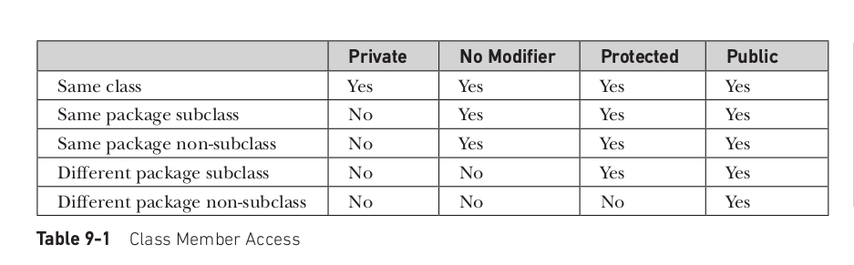
Access Protection

Slide 11
Access protection
A non-nested class has only two possible access levels: default and public.
When a class is declared as public, it is accessible by any other code.
If a class has default access, then it can only be accessed by other code within its same package.
When a class is public, it must be the only public class declared in the file, and the file must have the same name as the class.

Slide 12
Access the package
There are three ways to access the package from outside the package.
import package.*;
import package.classname;
fully qualified name.

Slide 13
Access the Package from outside
package pack;
public class A{
public void msg(){System.out.println("Hello");}
} } A.java
package mypack;
  import pack.*;
  import pack.A;
class B{
public static void main(String args[]){
pack.A obj = new pack.A();//using fully qualified name
obj.msg();
}
} B.java

Slide 14
Importing Packages
In a Java source file, import statements occur immediately following the package statement (if it exists) and before any class definitions.
import pkg1 [.pkg2].(classname | *);
Here, pkg1 is the name of a top-level package, and pkg2 is the name of a subordinate package inside the outer package separated by a dot (.). There is no practical limit on the depth of a package hierarchy, except that imposed by the file system.
Finally, you specify either an explicit classname or a star (*), which indicates that the Java compiler should import the entire package.
import java.util.Date;
import java.io.*;

Slide 15
package MyPack;
public class Balance {
String name;
double bal;
public Balance(String n, double b) {
name = n;
bal = b;
}
public void show() {
if(bal<0)
System.out.print("--> ");
System.out.println(name + ": $" + bal);
}
}

Slide 16
import MyPack.*;
class TestBalance {
public static void main(String args[]) {
Balance test = new Balance("J. J. Jaspers", 99.88);
test.show(); // you may also call show()
}
}
As an experiment, remove the public specifier from the Balance class and then try compiling TestBalance

